Slide 2

Installing Git

Slide 3
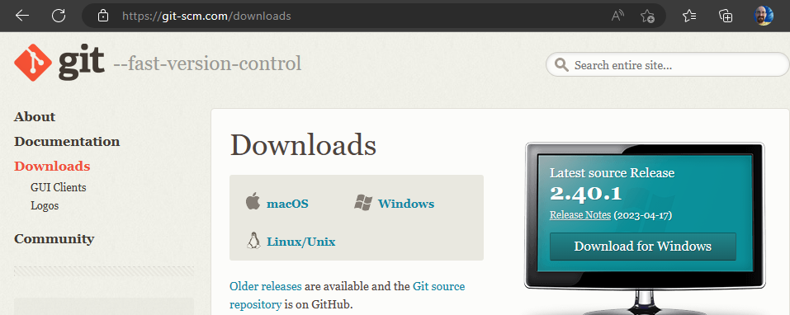
https://git-scm.com/downloads

Slide 4
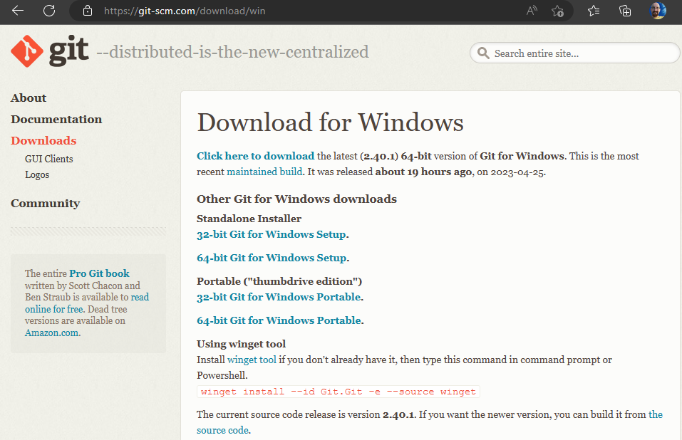

Slide 5


Slide 6
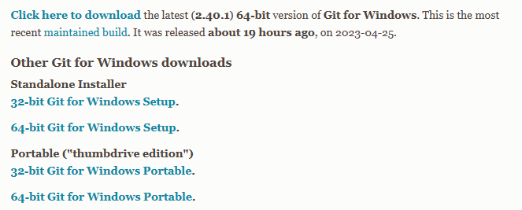

Slide 7
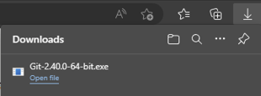

Slide 8
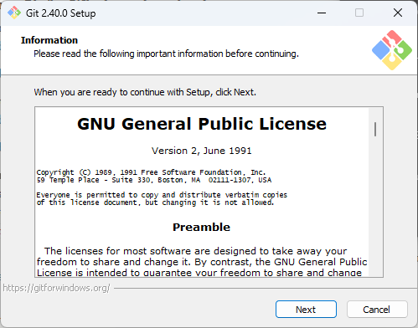
License (Next)

Slide 9
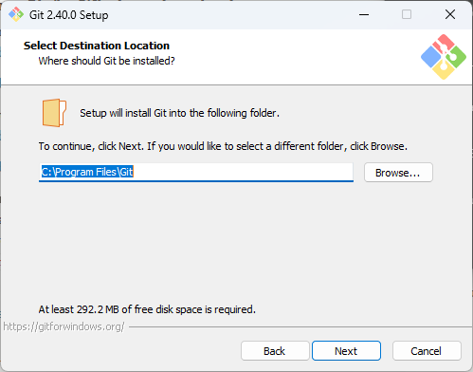
Install Location (Next)

Slide 10
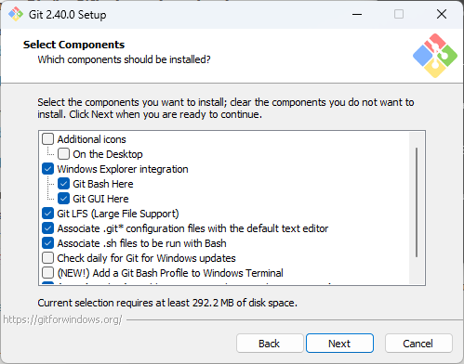
Components (Next)

Slide 11
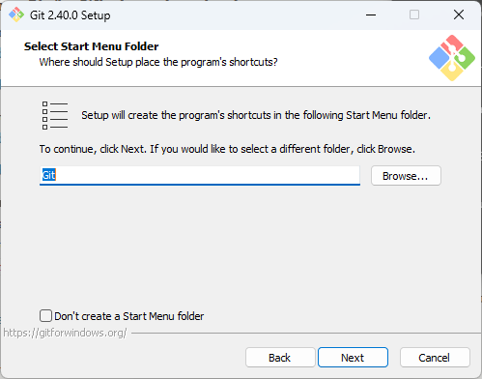
Start menu (Next)

Slide 12
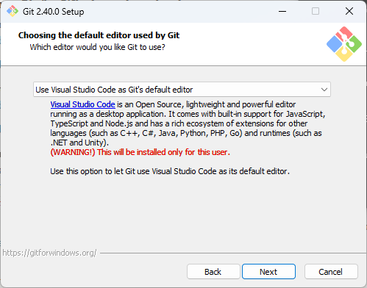
Default Editor: (Visual Studio Code)

Slide 13
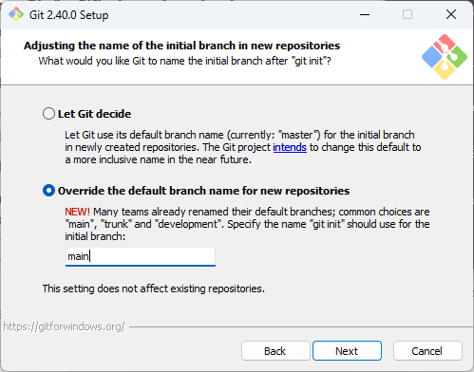
Default Branch Name: (main)

Slide 14
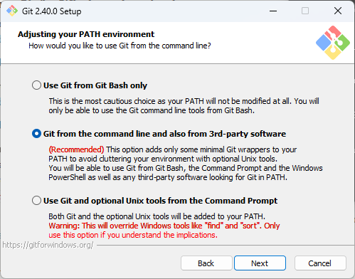
Add to path (Next)

Slide 15
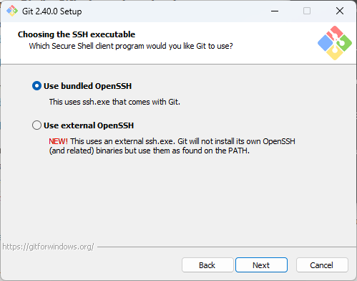
SSH (Next)

Slide 16
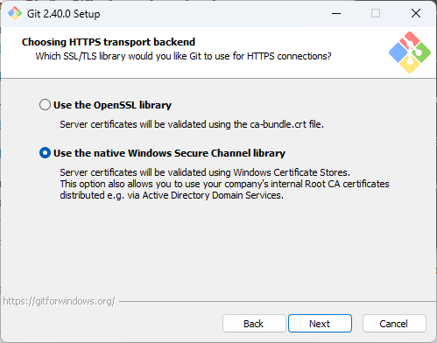
HTTPS: Windows Secure Channel

Slide 17
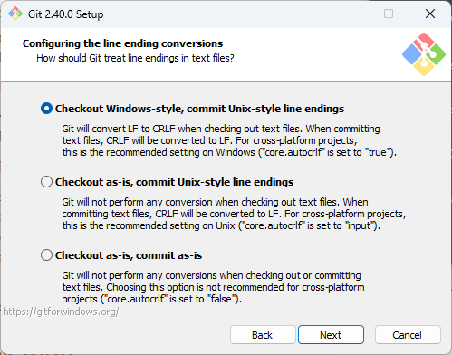
Line endings: LF/CRLF (NEXT)

Slide 18
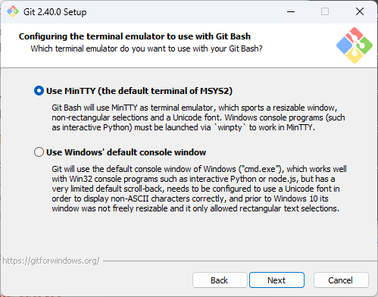
Git bash (Next)

Slide 19
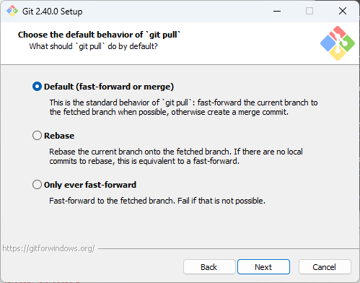
Git pull behavior (Next)

Slide 20
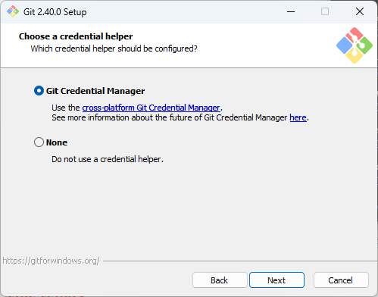
Credential helper (Next)

Slide 21
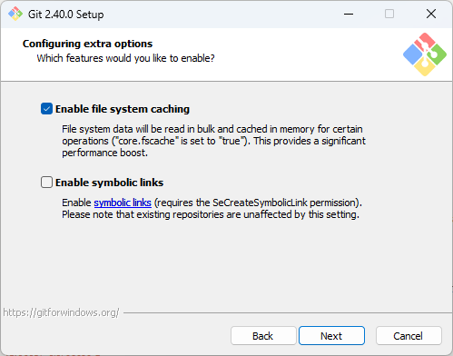
Extra Options (Next)

Slide 22
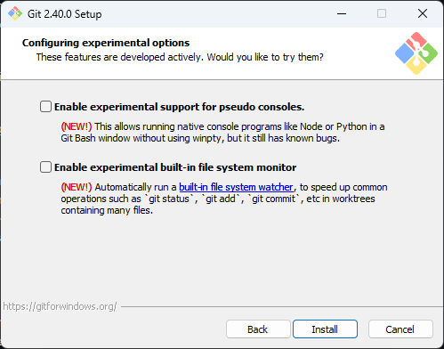
Experimental Options (Next)

Slide 23
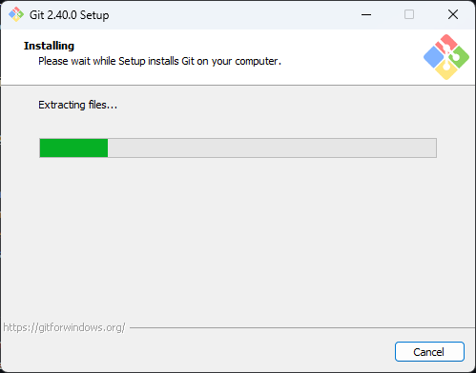

Slide 24
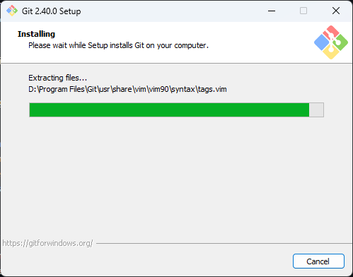

Slide 25


Slide 26


